Slide 1
Next-Generation Real-Time Geodetic Station Sensor Web for Natural Hazards Research and Applications
Yehuda Bock (PI, SIO)
Angelyn Moore (Co-I,JPL), Sharon Kedar (Co-I,JPL)
Frank Webb (Co-I, Institutional PI, JPL)
Robert Clayton (Co-I, Institutional PI, Caltech)
Seth Gutman, Jayme Laber, Ivory Small (Co-I’s, NOAA)
AIST-11-0072
Interim Review
Presented: November 25, 2013

Slide 2
Overall Goal
To better forecast, assess, and mitigate risk for natural hazards, including earthquakes, tsunamis, and extreme storms and flooding

Slide 3
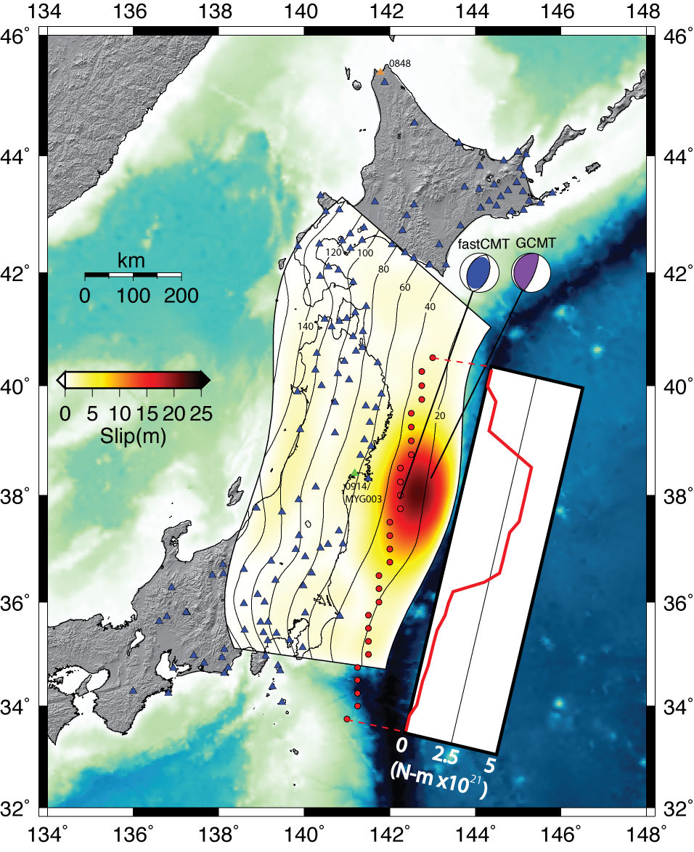
Next-Generation Real-Time Geodetic Station Sensor Web
for Natural Hazards Research and Applications
PI: Yehuda Bock, Scripps Institution of Oceanography, University of California at San Diego
Objectives
Develop a power-efficient, low-cost, plug-in Geodetic Module as a prototype for the next-generation geodetic station, including GPS, accelerometer and meteorological sensors
Generate on-the-fly higher-order data products including millimeter-level displacements and precipitable water within the geodetic module rather than at a central processing facility as has been the prevailing paradigm
Develop a real-time Sensor Web to allow autonomous sensors to transmit and receive information with the geodetic module via regional nodes and central facilities to allow for control functions, data, data product, model exchanges and alarming
Transfer capabilities to NOAA and CISN as part of a technology infusion proposal, for decision and rapid response to natural hazards emergencies including earthquakes, tsunamis, severe storms, atmospheric rivers, and flooding
Order of magnitude improvement compared to seismic methods with CMT and slip inversion in simulated real-time mode obtained within 3 minutes for the 2011 Mw 9.0 Tokachi-oki earthquake using seismogeodesy (displacements and accelerations). Triangles show station locations. Red circles show extent of line source of CMT solutions, the final averaged solution shown as fastCMT, and Global CMT solution. The inset shows the moment release from the line source of CMTs as a function of distance along fault. Shown along the fault interface with 20 km depth contours is the result of the slip inversion.
Approach
Leverage existing real-time continuous GPS in Western North America and technology developments from earlier and ongoing NASA projects, including SIO telemetry buffer for streaming high-rate GPS data, real-time GPS Sensor Grid, algorithms for optimal combination of GPS and strong-motion accelerometer data, and GPS meteorology
Design hardware components at SIO taking advantage of off-the-shelf products, use local vendors for manufacturing, use sub-contractor for real-time firmware, and SIO programmers for real-time algorithm development
Key Milestones
Develop Geodetic Module, MEMS accel. & met. packages 12/12
Upgraded 5 GPS stations (with accelerometers) 11/13
Embed in the Geodetic Module the Kalman filter for output of displacements and precipitable water 12/14
Upgrade 10 additional GPS stations (accelerometers) 11/13
Deploy Prototype Sensor Web 06/14
Upgrade 10 additional GPS stations 12/14
Technology infusion to NOAA 06/15
Integration of GPS water vapor into AWIPS-II 06/16
Co-Investigators:
Frank Webb, Sharon Kedar, Angelyn Moore, JPL; Robert Clayton, Caltech; Ivory Small, Jayme Laber, NWS; Seth Gutman, NOAA
TRL_{in} = 4: TRL_{FirstAnnual} = 5
04/12
Notes:
3

Slide 4
Presentation Outline
Cover Page
Quad Chart with Objectives
Overall Goal
Team Members Matrix
Project Overview
Primary Accomplishments and Technical Findings
Plans for Upcoming Review Period (short-term goals)
Critical Issues
Student Participation (Graduate, Undergraduate, Elementary)
Synergies with NASA
Media
Publications and Presentations
Synergies with other Organizations
Schedule Chart (from proposal, full project period)
System Requirements and Schedule Status
Costs UCSD (for duration of project; includes Caltech subaward)
Costs JPL (for duration of project)
JPL Workforce Status
Costs Entire Project (for duration of project)
Acronyms

Slide 5
Team Members – SIO and Caltech
Name | Org | Roles & Contributions
Yehuda Bock | SIO | Project PI, AIST-08 PI, GPS/seismic integration, GPS analysis, Earthquake Early Warning Systems (EEWS)
Peng Fang | SIO | SIO support of NOAA’s GPS Met program; ultra-rapid orbits, PPP-AR post-processing
Jianghui Geng | SIO | Postdoctoral researcher; precise point positioning, ambiguity resolution
Jennifer Haase | SIO | Researcher, GPS/seismic integration, seismology
Diego Melgar | SIO | PhD candidate at SIO; GPS/seismic integration, rapid earthquake modeling
Dara Goldberg | SIO | First year graduate student, shake table experiments, EEWS
Jessie Saunders | SIO | First year graduate student, shake table experiments, EEWS
D. Glen Offield | SIO | Radio Engineer; designed SIO Telemetry Buffer, Geodetic Module, MEMS accelerometer and meteorological packages, instrument testing and deployment
Melinda Squibb | SIO | Senior Programmer; JAVA and real-time applications programmer, migrating PPP-AR software
Anne Sullivan | SIO | Systems administrator; real-time GPS archive quality control
Robert Clayton | Caltech | Project Co-I, Institutional PI, PI Southern California Earthquake Data Center, California Integrated Seismic Network; MEMS accelerometers, Community Seismic Network
Ellen Yu | Caltech | Manager of Southern California Earthquake Center, archiving broadband displacement waveforms

Slide 6
Team Members – JPL and NOAA
Name | Org | Roles & Contributions
Frank Webb | JPL | Project Co-I and institutional PI, MEaSUREs PI; AIST-08 Co-I; Extensive experience in space geodesy, crustal deformation monitoring, and GPS analysis methods
Sharon Kedar | JPL | Project Co-I, AIST-08 Co-I; sensor grids for volcano monitoring, seismology
Angelyn Moore | JPL | Project Co-I, Lead developer on AIST-08 for GPS troposphere correction maps, interface with NOAA
Susan Owen | JPL | PI, Caltech/JPL ARIA project for rapid response to natural disasters
Seth Gutman | NOAA | Project Co-I, Physical Scientist, NOAA Earth System Research Laboratory (ESRL) Technology Infusion – Precipitable water & extreme weather
Kirk Holub | NOAA | ESRL, GPS meteorology
Jayme Laber | NOAA | Project Co-I, Senior Service Hydrologist, NOAA National Weather Service, Oxnard Technology Infusion – Precipitable water & extreme weather
Ivory Small | NOAA | Project Co-I, Science and Operations Officer (SOO), NOAA National Weather Service, San Diego; Technology Infusion – Precipitable water & extreme weather

Slide 7
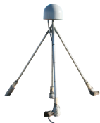
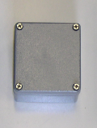

Data Fusion
Enhance GPS technology with low-cost sensors to mitigate risk for natural hazards:
Very-high-rate (1-100 Hz) broadband displacements with 1-2 s latency and mm accuracy in three dimensions
+
=
MEMS Accelerometer
Module
GPS/GNSS
Continuous mm-level precipitable water vapor (PWV in the troposphere)
+
=
MEMS Met Sensors
(pressure, temperature)
GPS/GNSS

Slide 8
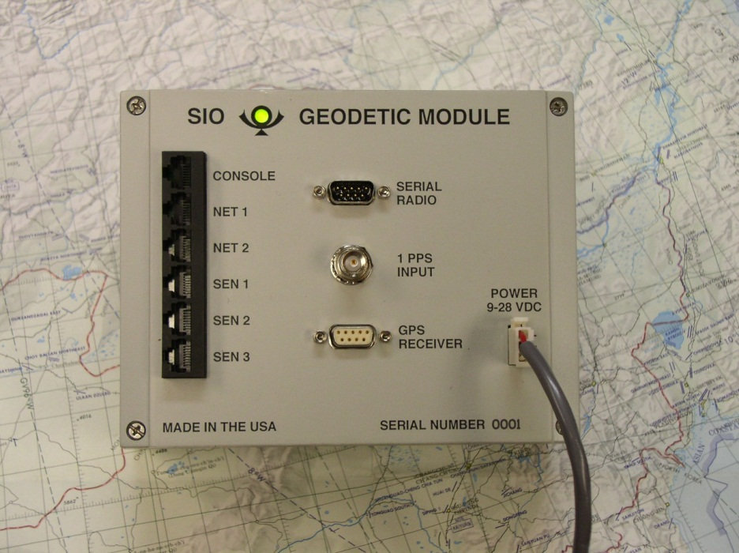
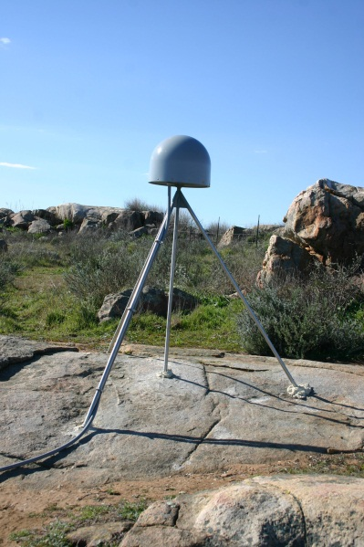
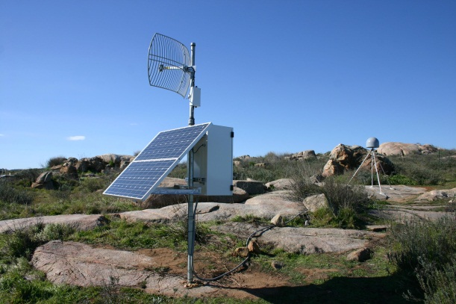
Project Components and Data Flow
Sensor
Web
Displacements
Velocities
PWV
Alerts
GAM: GPS, Accelerometer, Met raw data
SGM: seismogeodesy/meteorology analysis and output
ACE: ambiguity, clock, ephemeris
GAM client
ACE upload
SGM in house
SGM
ACE
GAM
SGM
SGM in module
MEMS
Sensors
Serial
SIO
Accel.
Serial
Serial
SIO
Met.

Slide 9
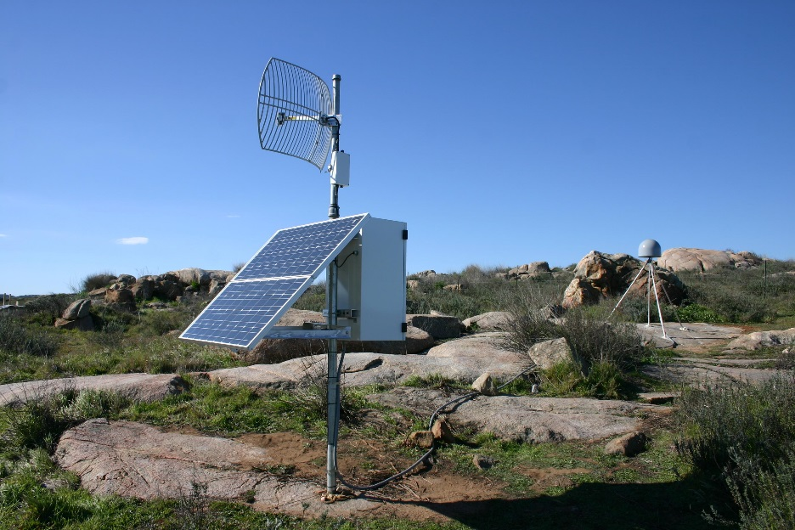
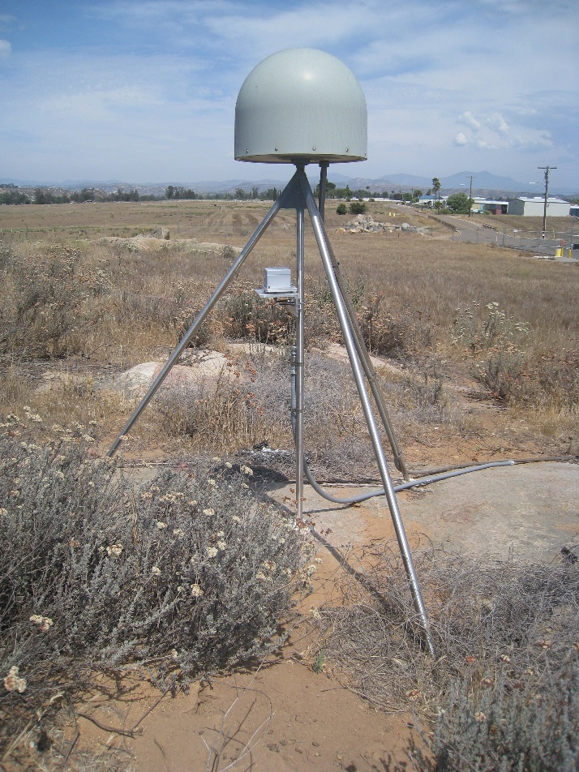
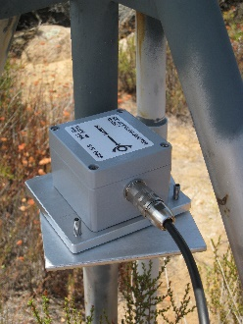
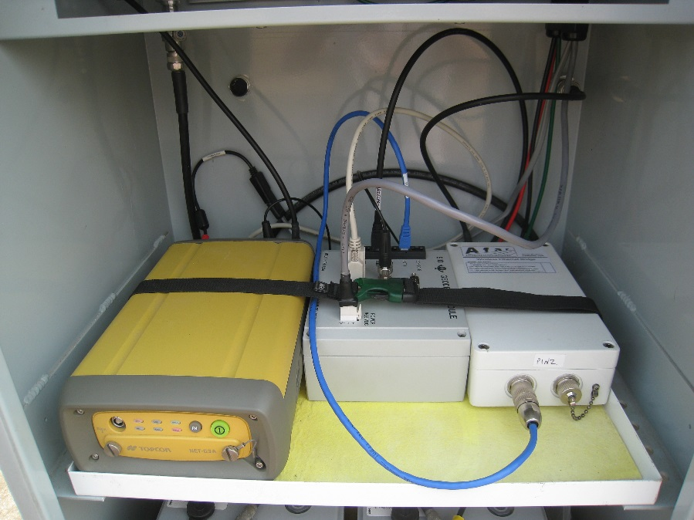
Fusion of GPS and Seismic Data: Seismogeodesy
Upgraded GPS station RAAP
MEMS accelerometer deployed on GPS monument
Geodetic Module in equipment box

Slide 10
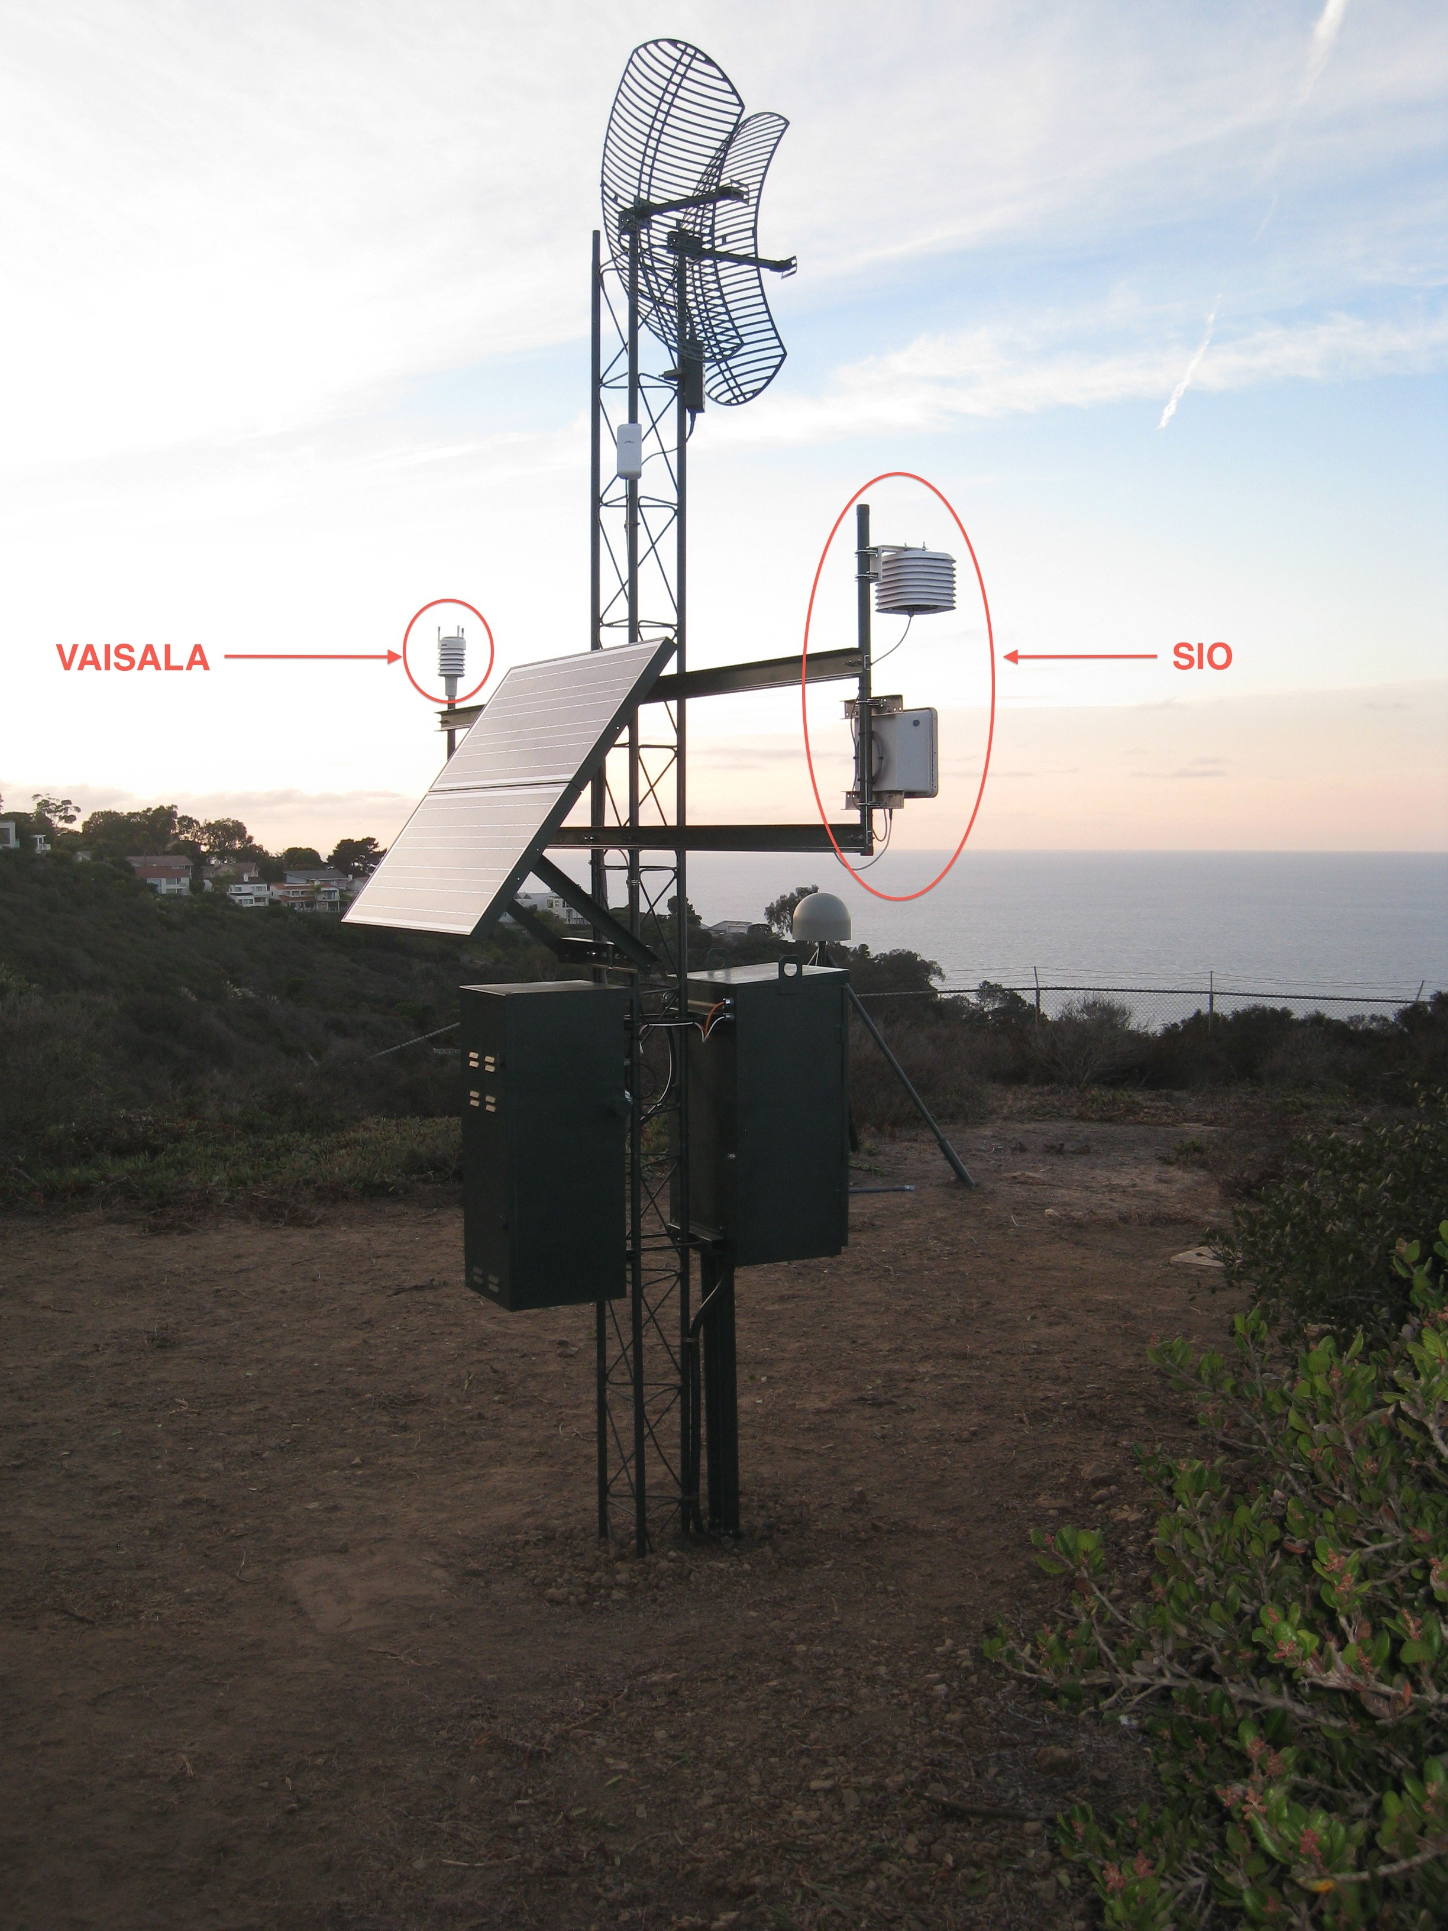
Fusion of GPS and Meteorological Data
Station SIO5 on Mount Soledad, La Jolla has been upgraded with SIO Geodetic Module, MEMS Accelerometer Package and MEMS Meteorological Package. A high-end Vaisala WXT-510 Multi-Weather Sensor has been deployed as well as a comparison with the less expensive prototype SIO met package.
Time-tagged 1 Hz GPS and 100 Hz accelerometer data, and 5 s pressure and temperature data are being continuously streamed to SIO. The GPS and met data will provide estimates of precipitable water above that location.
Maximum surface slip

Slide 11
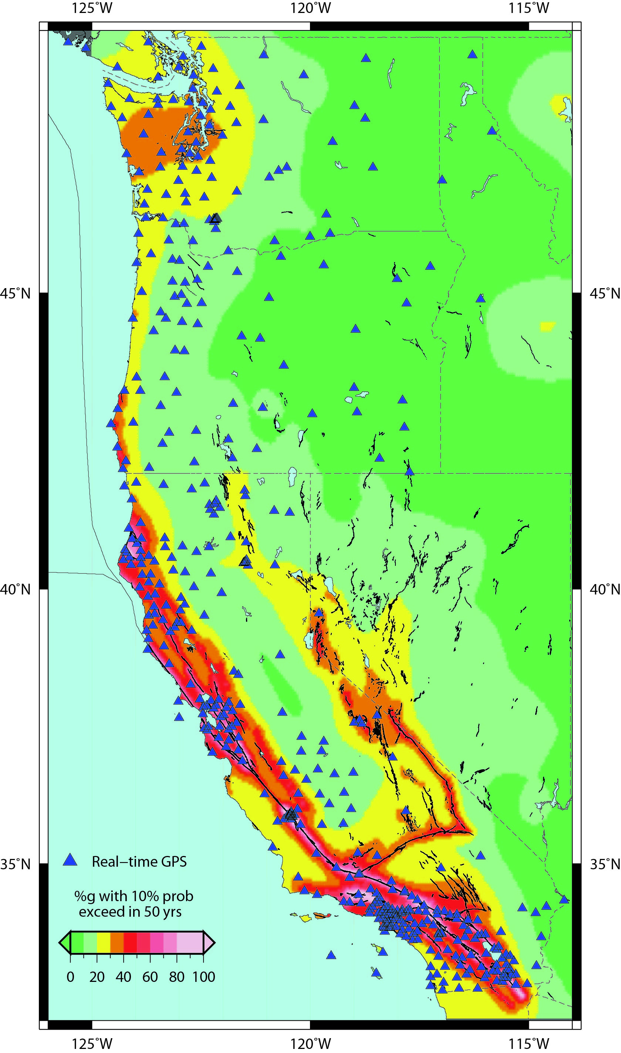
Real-time GPS Network on West Coast
An earthquake & tsunami of the magnitude of Mw 9.0 Tohoku-oki earthquake is possible on Cascadia Subduction Zone
Since early 1990’s ~1600 CGPS stations were established for crustal deformation research in Western North America. Initial mode was 15-s sampling and 24-hour downloads & positions
Sub-networks have been upgraded to provide real-time (<1 s) high-rate (1 Hz) or greater positions (SCIGN, PBO, BARD, PANGA, WCDA)
Combined into a unified network: Real-Time Earthquake Analysis for Disaster Mitigation Network (READI) (~600 stations)
Very few GPS/seismic collocations
There is increasing risk of a large earthquake on the Hayward fault in the Bay Area
We are overdue for a large earthquake on the southern San Andreas fault
Notes:
11

Slide 12
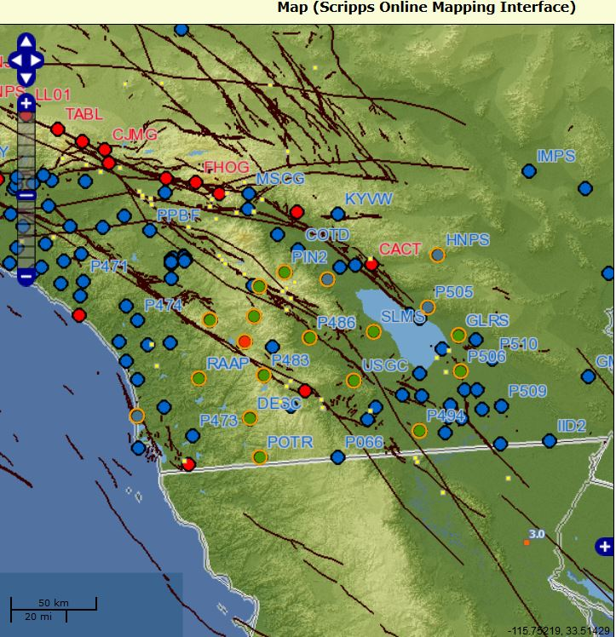
Fusion of GPS and Seismic Data:
Deployment of Instruments
SIO Geodetic Modules and Accelerometer Packages have now been deployed and are operating at 17 of 19 stations (green dots) chosen for upgrades along the southern San Andreas fault system in southern California.
Time-tagged 1 Hz GPS and 100 Hz accelerometer data are being continuously streamed to SIO and will be shortly input to a Kalman filter to estimate displacement and velocity waveforms with a latency of a few seconds.
Maximum surface slip

Slide 13
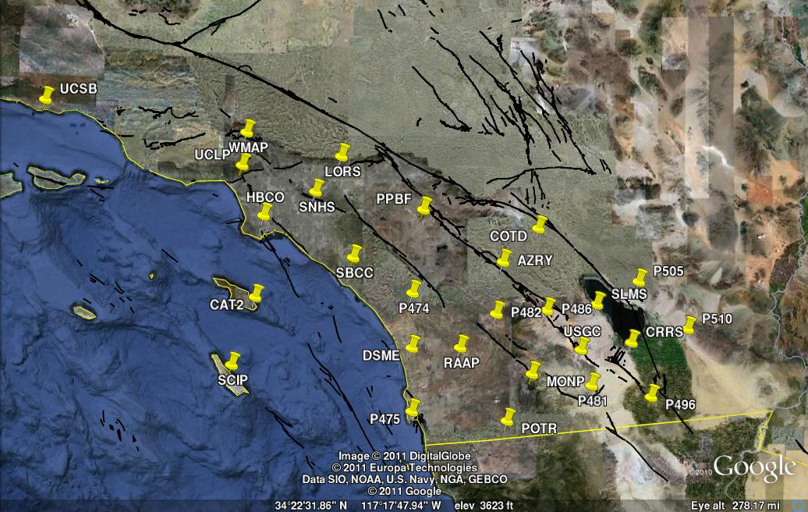
Stations slated for GPS/Met fusion
GPS sites in the project area being used to investigate higher (15-min or less) resolution GPS PW estimates to improve subjective and objective forecasts of moisture-related severe weather events including heavy precipitation associated with land-falling Atmospheric Rivers in wintertime, the summertime North American Monsoon, and Santa Ana conditions associated with fire weather events in the fall.

Slide 14
Seismogeodetic analysis
Loosely-coupled (Bock et al., BSSA, 2011)
Accelerometer data corrected for gain provide the state information for a Kalman filter – assumption is that accelerations are constant between sampling epochs
GPS displacements estimated by one of GPS analysis methods are the observations
Tightly-coupled (Geng et al., G³, 2013)
Extension of precise point positioning with ambiguity resolution (PPP-AR), by adding accelerometer data corrected for gain
Input to Kalman filter are accelerations and GPS observations (phase and pseudorange)
Allows improvement in detection of cycle slips and resolution of GPS integer-cycle phase ambiguities

Slide 15
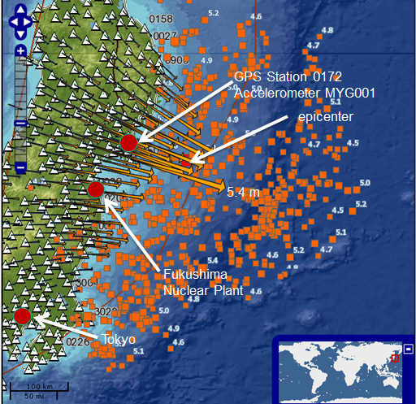
Fusion of GPS and Seismic Data:
2011 Mw 9.0 Tohoku-oki Earthquake & Tsunami
Coseismic displacements for 2011 Mw 9.0 Tohoku-oki earthquake computed from Japan’s 1200+ station CGPS Network (GEONET) by ARIA group at Caltech/JPL (Susan Owen, PI). Maximum surface displacement on land was 5.24 meters at station 0550 on coast about 100 km from epicenter
Identified 142 “collocated” NIED stations with triggered 100 Hz KiK-net and K-Net accelerometer data
(e.g., 0914/MYG003) and estimated 100 Hz displacements and velocities using a Kalman filter
Maximum surface slip

Slide 16
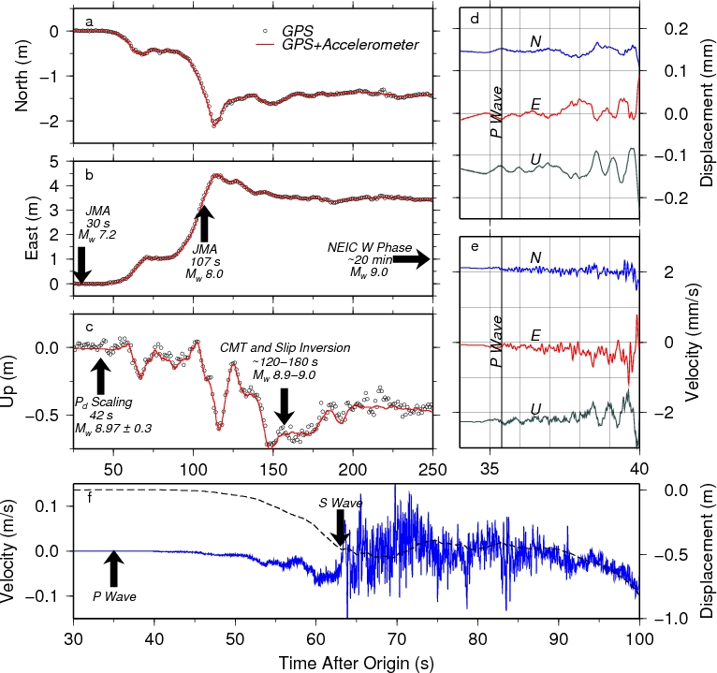
Fusion of GPS & Seismic Data: 2011 Mw 9.0 Tohoku-oki event
Source:
Melgar et al., GRL, 2013

Slide 17
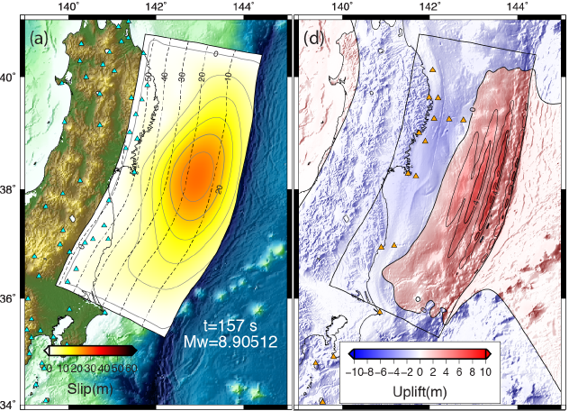
Finite source model and seafloor uplift:
2011 Tohoku-oki Mw 9.0 earthquake
Source Slip Model
Seafloor Uplift
Source: Melgar and Bock, JGR, 2013

Slide 18
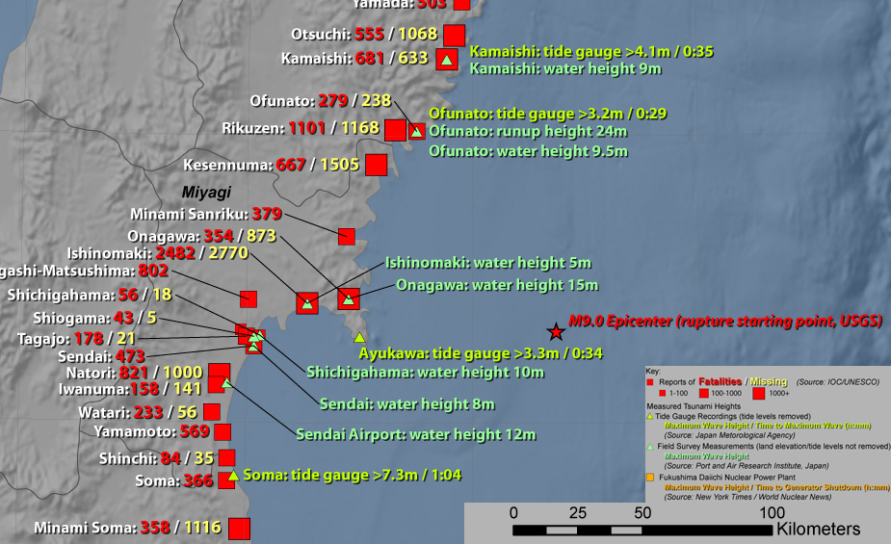
Tsunami travel times for 2011 Mw 9.0 Tohoku-oki earthquake
Rapid high-order modeling of large subduction zone earthquakes is critical for accurate tsunami warnings

Slide 19
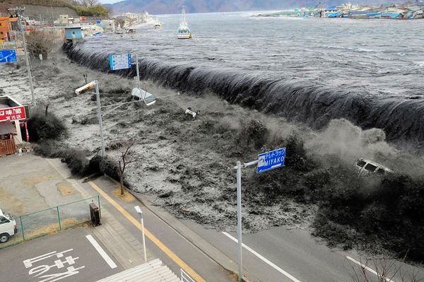
Model of 2011 Tsunami in Honshu: Movie
2011 Honshu Japan
(National Geographic)

Slide 20
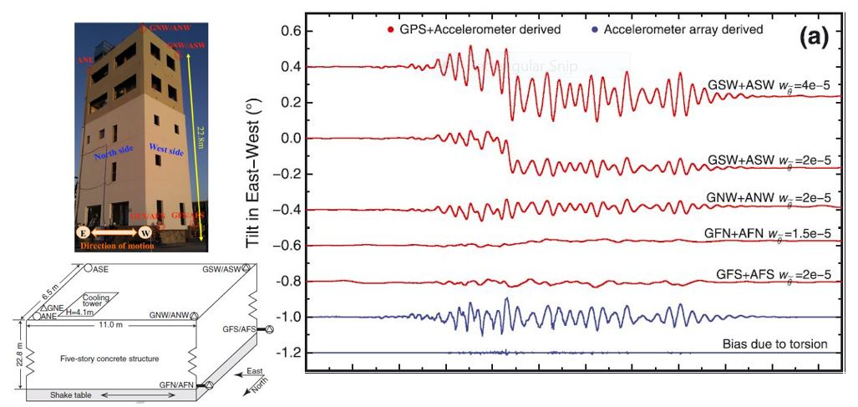
2012 Shake Table Test:
Seismogeodetic Estimation of Coseismic Tilts
Source: Geng et al., GRL, 2013

Slide 21



Architecture for seismogeodetic data archival
The method of data transfer between SOPAC and SCEDC is to have a wave pool at each center. Files would be copied from the SOPAC wave pool to SCEDC. The advantage of this system is that data is not lost when either of the two systems is not reporting..
1) Copy processes pull waveforms from SOPAC to SCEDC
2) The files are converted to mini-seed format in the staging wave pool.
3) The files are archived and accessible to the user community
SCEDC
Archive
getGPS
eRYO file
(seismogeodetic data
Velocity and displacement)
archiveGPS
eRYO
file
mSEED
file
getTransit
eryo2mseed
Accelerometer transit file
archiveTransit
Accelerometer transit file
(seismic data)
ac
mSEED
file
ac
transit2mseed
Real-time wave pool
staging wave pool
Users can download these
waveforms to their local disk
in format standards such as
SAC and mini-seed via a
client program called “AISTstp”
STP
client

Slide 22
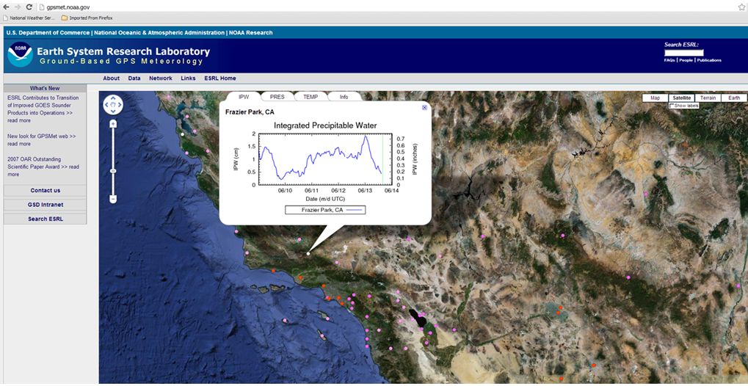
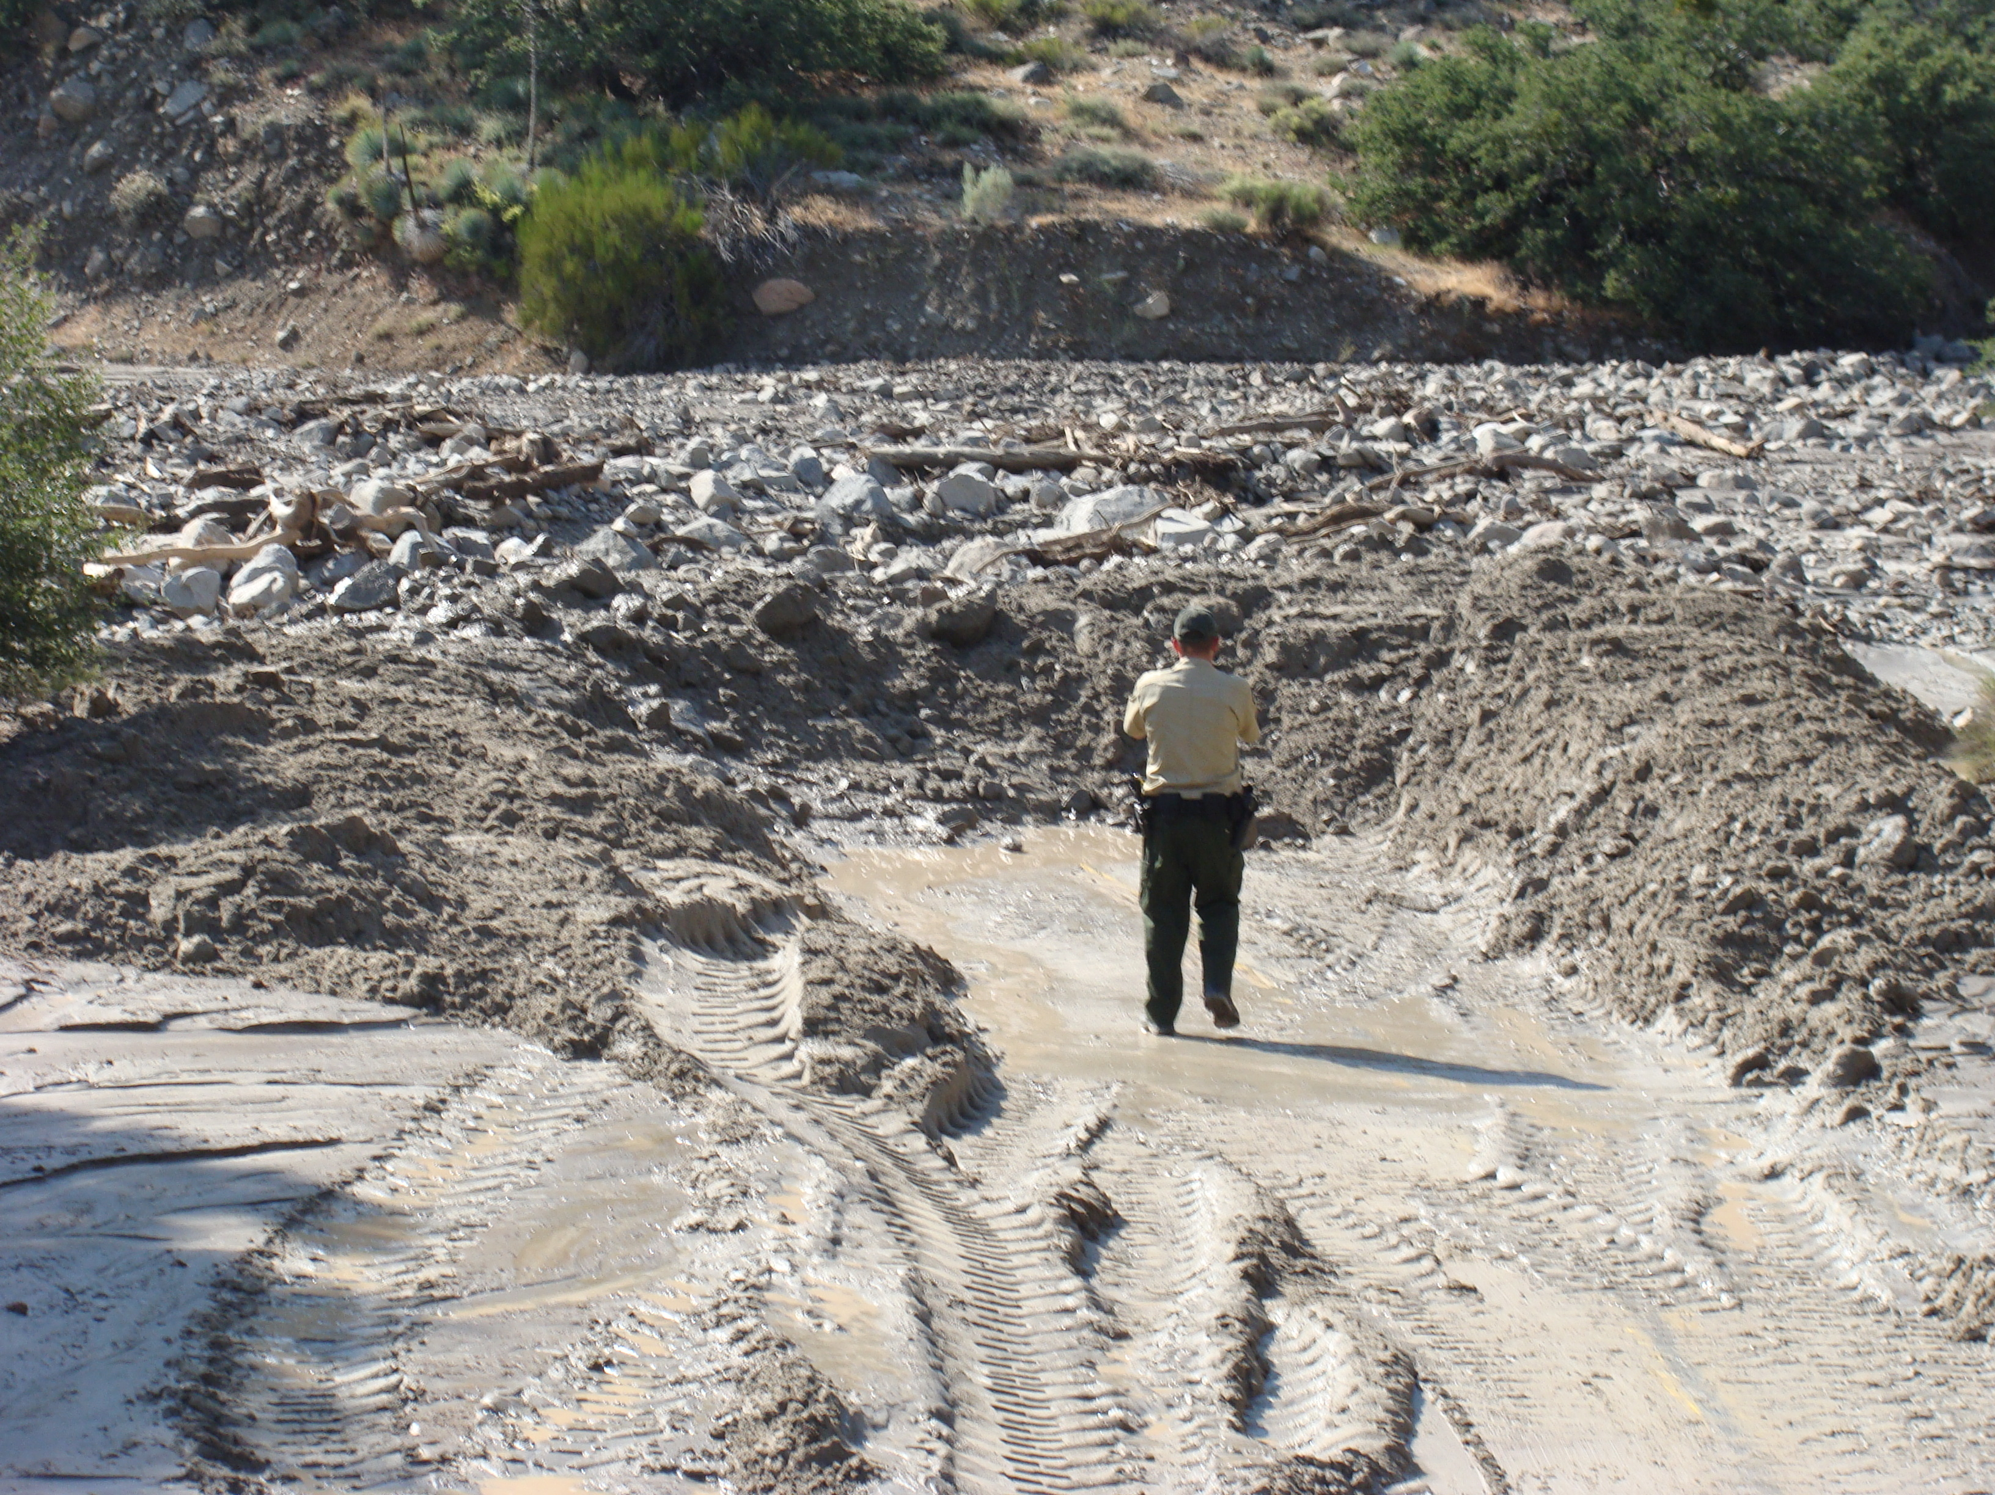
Densification of SoCal Sites in
NOAA ESRL’s Operational GPSMet network
5 more sites added in May-Nov 2013
The Frazier Park site (with callout) is especially appreciated by the Oxnard forecast office for its location in the northern Ventura county mountains, commonly affected by summer convection. The area’s main road has low water crossings that experience flash flooding.

Slide 23
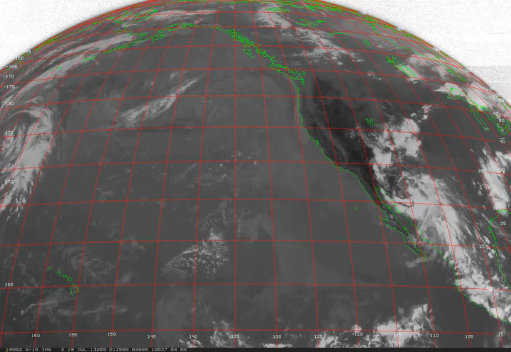
North American Monsoon Season 2013
Several monsoon events occurred in July and August
Forecasters noted the use of GPS PW in their Area Forecast Discussions:
“SUBTROPICAL MOISTURE MOVING INTO THE DESERTS OF SOUTHEAST CALIFORNIA THIS MORNING. GPS PRECIPITABLE WATER VALUES HAVE ALREADY CLIMBED TO AROUND 1.7 INCHES FOR AREAS AROUND THE SALTON SEA. “
"ITS POSSIBLE THAT THIS INVERSION IS HELPING TO SQUELCH SIGNIFICANT CONVECTIVE ACTIVITY THIS AFTERNOON...BECAUSE A GPS-MET INTEGRATED PRECIPITABLE WATER STATION IN LA QUINTA WITH A VALUE NEAR 1.8 INCHES AND DEW POINTS IN THE 70S IN THE COACHELLA VALLEY WOULD INDICATE THAT THERE IS MORE THAN ENOUGH MOISTURE FOR CONVECTION.”
San Diego SFO Science & Operations Officer Ivory Small wrote a white paper on the use of GPS IPW in the July event, in the absence of a Yuma sounding, to issue a flash flood warning prior to verified flooding.

Slide 24
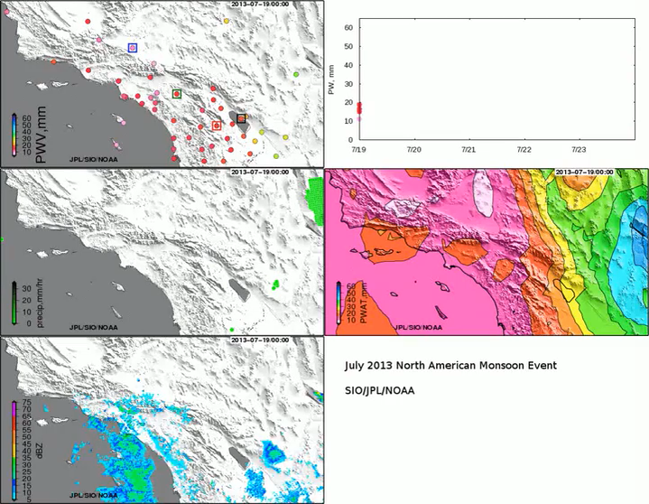
Visualizing the Monsoon
Creating views of various data types, to stimulate thought on what types of displays forecasters would prefer to see in AWIPS II used for interactive viewing by NOAA forecasters
GPS PW
GPS PW (stations boxed at left)
RAP PW
Stage II Blended Precip
Radar (base reflectivity)

Slide 25
Primary Accomplishments and Technical Findings:
GPS/Seismic Fusion
25 Geodetic Module and MEMS accelerometer hardware packages (GM) have been produced as part of this and other NASA and NSF projects.
17 stations along the southern San Andreas fault system have been upgraded with GM and are operational.
1 Hz GPS and 100 Hz accelerometer data are being streamed to SIO server with a latency of a few seconds.
Data are being converted into displacement and velocity waveforms using loosely-coupled Kalman filter.
Data are archived at SIO and at Caltech/SCEDC in seismic SAC format
Published five papers in 2013 on 2011 Mw 9.0 Tohoku-oki earthquake and tsunami, lower limits of sensitivity of seismogeodesy using data from 26 September 2012 Brawley swarm and precise point positioning with ambiguity resolution (PPP-AR).
READI network in the western U.S. – streaming and archiving 1 Hz GPS data from over 500 stations.
Operating real-time PPP-AR service using GPS stations in North America to estimate satellite clocks and fractional clock biases (FCBs), in support of PPP-AR positioning from READI stations.
Progress in migrating PPP-AR software from Fortran to Java environment.

Slide 26
Primary Accomplishments and Technical Findings:
GPS/Meteorology Fusion
Incorporated data from 26 stations into NOAA ESRL’s ongoing operations, resulting in roughly a 50% decrease in PWV uncertainty. GPS PW estimates were assimilated hourly and half-hourly into two NOAA rapid-refresh numerical weather prediction models – nRAP with 13 km horizontal resolution and 1-hr assimilation cycle and LAPS at 3 km horizontal resolution with ½-hr resolution.
NOAA weather forecasters in San Diego used upgraded network to forecast a summer monsoon event in July 2013 and issue an accurate and timely flood warning (press conference at Fall AGU meeting in San Francisco). Forecasters at Oxnard have been utilizing this system since 2012 via ESRL’s web page operationally and found it to be an effective tool, in some cases preferring the GPS measurements over models in making forecast decisions.
Meteorological prototype deployed at GPS station SIO5 for validation of MEMS approach for PWV.
Comparison of ZTD from post-processed 1-sec PPP solutions with JPL 5-min average and ESRL 30-min average solutions have determined that the accuracy and precision of more frequent estimates should be suitable for operational implementation by NOAA.
Power spectrum analysis of the 1-sec PPP solutions by ESRL indicates that there may be sufficient information about atmospheric turbulence in the high-rate GPS observations to be useful for aviation weather forecasting applications. ESRL intends to evaluate this when a reliable stream of observations are available for testing and evaluation.

Slide 27
Plans for upcoming review period (Short-term goals)
Complete implementation of loosely-coupled real-time Kalman filter to estimate displacement and velocity waveforms from 1 Hz GPS and 100 Hz accelerometer data. Archive results at Caltech/SCEDC. Concentrate on southern San Andreas fault system.
Transition from loosely-coupled to tightly-coupled filter for estimation of broadband displacements and velocities.
Stream 1 Hz GPS data and 100 Hz accelerometer data from UC Berkeley Seismological Laboratory and estimate broadband displacements.
Test streaming of GPS, accelerometer and meteorological data from upgraded CGPS station (SIO5) to estimate PWV and broadband displacements
Sustain the flow of current GPS-Met data and products including the new stations added to support this project to NOAA forecasters, modelers, and NOAA, NASA and university researchers.
Determine and correct bias between SIO and JPL solutions and NOAAMet model troposphere delay estimates.
Evaluate higher temporal resolution (1 Hz) troposphere signal delay product
Complete mock-up of interactive display of GPS and other met data for consideration for implementation into AWIPS-II.
Develop and test data processing techniques to produce and display higher resolution GPS PW, upslope moisture flux and tropospheric signal delay products on AWIPS and other work stations.

Slide 28
Critical Issues
Re-evaluate CPU requirements for embedding PWV and broadband displacements software into the Geodetic Module after migration of code to Java environment is completed – consider further migration to some version of C programming language.
Determine if low-cost MEMS met sensors are sufficiently precise and accurate for PWV applications based on collocation at SIO5 station – if positive, continue to production; if not, consider alternatives.
Complete design (protocols) for Geodetic Sensor Web. Awaiting discussions with San Diego County Office of Emergency Services and UCSD Health System to define requirements, and input from NOAA partners.

Slide 29
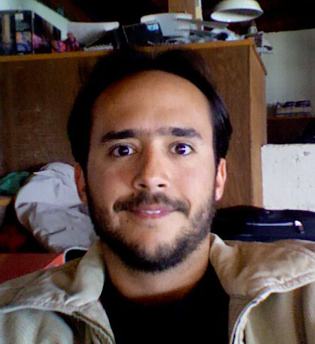


Graduate Student Participation
Diego Melgar, 5th year graduate student at SIO
GPS/seismic integration with Kalman filter, quality control
CMT analysis, kinematic waveform inversions, tsunami modeling
Dara Goldberg (far left) & Jessie Saunders
1st year graduate students at SIO
Shake table experiments to test MEMS accelerometers for EEW

Slide 30
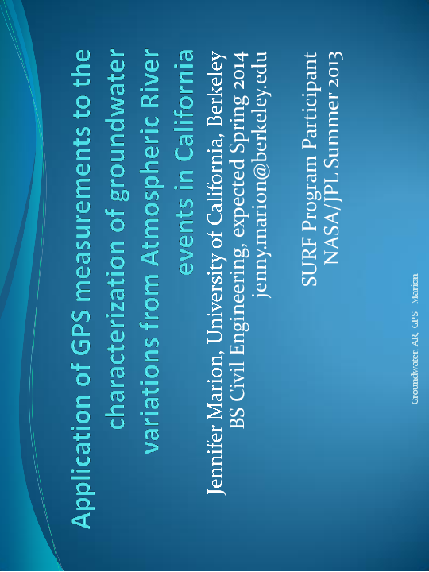
Undergraduate Student Participation
JPL Summer Student J. Marion worked with D. Waliser, F. Webb, and A. Moore

Slide 31
Elementary School Student Participation
Visit by Capri Elementary School Encinitas, Lego Robotics Team to SIO on July 31.
Several presentations and demonstrations by Y. Bock, J. Haase and D. Melgar over a three-hour period

Slide 32
Synergies/collaborations with NASA
Active Projects:
ROSES-ACCESS: Prototype earthquake and tsunami early warning system for the Western U.S. (Y. Bock, PI; John Labrecque, program manager)
ROSES-ACCESS Earth Science Applications: Disasters – Feasibility study using real-time GPS/seismic displacements to improve disaster management and decisions pertaining to rapid assessment of structural damage from earthquakes and tsunamis (Y. Bock, PI, J. Restrepo, Co-I at UCSD Jacobs School of Engineering; Frank Lindsay, program manager),)
MEaSUREs - II: Solid Earth Science ESDR System (Y. Bock, PI; Martha Maiden, program manager )
JPL QuakeSim project (A. Donnellan, PI)
Caltech/JPL ARIA project (S. Owen, PI)
Notes:
32
SC, AD: Update

Slide 33
Media
NASA Press Release 12-108, NASA Tests GPS Monitoring System for Big U.S. Earthquakes (2012), http://www.nasa.gov/home/hqnews/2012/apr/HQ_12-108_GPS_Earthquake_Monitoring.html
SIO Press release at 2012 Fall AGU Meeting, “Hybrid GPS-Seismic System Aims to Accelerate Earthquake Hazard Response,” http://scrippsnews.ucsd.edu/Releases/?releaseID=1210
Andrea Martin, “Extreme Storm and Flooding Forecasts Improved by Sensor Network,” 2013 ESTO Weekly, April 23, 2013. http://esto.nasa.gov/news/news_Bock_4_2013.html
NASA Tech Brief, GPS Estimates of Integrated Precipitable Water Aid Weather Forecasters, 17659-npo-48881, November 1, 2013.
AGU Press Conference, Dec. 10, 2013, “Improved Warnings for Natural Hazards: A Prototype System for Southern California” (SIO, JPL, NOAA)

Slide 34
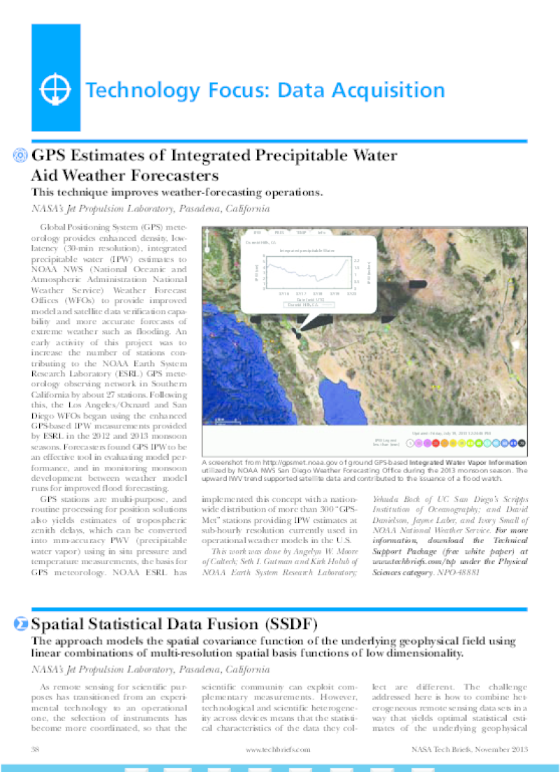
NASA Tech Briefs
NASA Tech Brief Nov 2013 on use of GPS PW in 2012 North American Monsoon Season
A NASA Software Tech Brief was published Sep 2013 on the GPS trop work from the Y. Bock AIST-08

Slide 35
Peer-Reviewed Publications
Crowell, B. W., Y. Bock and D. Melgar (2012), Real-time inversion of GPS data for finite fault modeling and rapid hazard assessment, Geophys. Res. Lett., 39, L09305, doi:10.1029/2012GL051318.
Melgar, D., Y. Bock, D. Sanchez and B. W. Crowell (2013), On robust and reliable automated baseline corrections for strong motion seismology, J. Geophys. Res., 118, doi:10.1029/2012JB009937.
Geng, J., Y. Bock, D. Melgar, B. W. Crowell, and J. S. Haase (2013), A new seismogeodetic approach applied to GPS and accelerometer observations of the 2012 Brawley seismic swarm: Implications for earthquake early warning, Geochem. Geophys. Geosyst., 14, doi:10.1002/ggge.20144.
Granat, R., J. Parker, S. Kedar, D. Dong, B. Tang and Y. Bock (2013), Statistical Approaches to Detecting Transient Signals in GPS: Results from the 2009- 2011Transient Detection Exercise, Seismo. Res. Lett., 84, 444-454. doi:10.1785/022013003.
Melgar, D., B. W. Crowell, Y. Bock, and J. S. Haase (2013), Rapid modeling of the 2011 Mw 9.0 Tohoku-oki earthquake with seismogeodesy, Geophys. Res. Lett., 40, 1-6, doi:10.1002/grl.50590.
Geng, J., D. Melgar, Y. Bock, E. Pantoli, and J. Restrepo (2013), Recovering coseismic point ground tilts from collocated high-rate GPS and accelerometers, Geophys. Res. Lett., 40, doi:10.1002/grl.51001.
Melgar, D. and Y. Bock (2013), Near-Field Tsunami Models with Rapid Earthquake Source Inversions from Land and Ocean Based Observations: The Potential for Forecast and Warning, J. Geophys. Res., 118, doi:10.1102/2013JB010506.

Slide 36
Abstracts and Presentations
Melgar, D., Y. Bock, B.W. Crowell, J. Geng (2012), Mitigation of Earthquake Hazards with a Seismogeodetic Model as Demonstrated for the 2011 Mw 9.0 Tohoku-oki Earthquake, 9th UJNR Panel on Earthquake Research, Denver, CO, October 9-12.
Moore, A., et al. (2012), Densification and Autonomization of Geodetic GPS Stations in Southern California Capable of Producing Tropospheric Delay and Precipitable Water Vapor Measurements, 2nd LAPS User Workshop, Denver, CO, 23-25 October.
Melgar, D., Y. Bock, B.W. Crowell, J. Geng, Novel methods in GPS data processing: Merging co-located high frequency GPS, accelerometer, and meteorological data at GPS stations, 3rd COCONet Workshop: Data and Research Workshop (Project Operations Meeting), October 24-26, 2012, Tulum, México.
Crowell, B. W. (2012), Improved Mitigation of Earthquake Hazards with Seismogeodesy, Stanford Departmental Seminar, Nov. 15.
Geng, J., Y. Bock, P. Fang, J. S. Haase (2012), Ambiguity-fixed GPS precise point positioning for earthquake and tsunami early warning in Western North America, Abstract G13C-08 presented at 2012 Fall Meeting, AGU, San Francisco, Calif., 3-7 Dec.
Bock, Y., R. W. Clayton, P. Fang, J. Geng, S. I. Gutman, S. Kedar, J. L. Laber, A. W. Moore, S. E. Owen, I. Small, M. B. Squibb, F. Webb, E. Yu (2012), Next-Generation Real-Time Geodetic Station Sensor Web for Natural Hazards Research and Application, Abstract IN31C-1505 presented at 2012 Fall Meeting, AGU, San Francisco, Calif., 3-7 Dec.
Moore, A. W., Y. Bock, J. Geng, S. I. Gutman, J. L. Laber, T. Morris, D. G. Offield, I. Small, M. B. Squibb (2012), Development of a System to Generate Near Real Time Tropospheric Delay and Precipitable Water Vapor in situ at Geodetic GPS Stations, to Improve Forecasting of Severe Weather Events, Abstract IN33C-1539 presented at 2012 Fall Meeting, AGU, San Francisco, Calif., 3-7 Dec.
Melgar, D., B. W. Crowell, Y. Bock (2012), Rapid Source Characterization of the 2011 Tohoku-oki Earthquake with Real-Time GPS and Strong Motion Data: Implications for Tsunami Warning, Abstract S53B-2492 presented at 2012 Fall Meeting, AGU, San Francisco, Calif., 3-7 Dec.

Slide 37
Abstracts and Presentations (Cont.)
Bock, Y. (2012), Earthquake & Tsunami Early Warning and Structural Monitoring with Seismogeodesy, Society of American Military Engineers (SAME), San Diego, Dec. 12.
Gutman, S., Y. Bock, P. Fang, A. Moore, and J. Mahoney (2013), Using ground-based GNSS observations to improve aviation turbulence monitoring and prediction, International Union of Radio Science (URSI) National Radio Science Meeting, Boulder, January 9-12.
Bock, Y., J. Haase, D. G. Offield, D. Melgar , J. Restrepo (2013), Real-Time Structural Monitoring and Disaster Mitigation using GPS/Seismic Technology, Triton Innovation Network (TriNet) Challenge, UCSD January 17.
Bock, Y. (2013), Early Warning and Rapid Response for Mitigating Natural Hazards, E.W. Scripps Associates Science Event: Behind-the-Scenes at Scripps: “Shaken, Not Stirred,” SIO, February 7.
Bock, Y. B, Crowell, D. Melgar, J. Haase, J. Geng, S. Kedar, A. Moore, R. Clayton, E. Yu, J. Restrepo, (2013), Prototype Earthquake, Atmospheric and Structural Early Warning System Using Seismogeodesy, Brown Bag Seminar, Seismological Laboratory, Caltech, March 18.
Haase, J. (2013), Using GPS Technology to Mitigate Natural Hazards, Ningbo University, China, April 11.
Melgar, D. (2013), Rapid Earthquake Source Models and Applications to Near-Source Tsunami Modeling, University of Washington, Seattle, April 21.
Melgar, D., J. Geng, Y. Bock, B. Crowell and J. Haase (2013), A Seismogeodetic Earthquake and Tsunami Early Warning System for Western North America, Institute of Navigation Pacific PNT 2013, Honolulu, Hawaii, April 23.
Bock, Y., J. Haase, D. Melgar (2013), Reducing Casualties and Damage Caused by Natural Hazards (Earthquakes, Tsunamis, Flooding) using Global Positioning System (GPS), Visit by Capri Elementary School Encinitas, Lego Robotics Team, La Jolla, July 31.
Geng, J., D. Melgar, Y. Bock, E. Pantoli, J. Restrepo (2013), Recovering coseismic point tilts from collocated GPS and accelerometers, 3rd International Working Group on Rotational Seismology, Christchurch, New Zealand, September 22 – 25.

Slide 38
Synergies with other Organizations
Central Washington University, READI project – Tim Melbourne)
California Spatial Reference Center (CSRC) – Rich Maher (Chair, Executive Committee)
UNAVCO/PBO – Glen Mattioli (PBO Director), Chris Walls (Chief Engineer, California)
Caltrans – Mark Turner, Scott Martin, Charles Sikorski (Principal: bridge monitoring)
San Diego County Office of Emergency Services – Leslie Luke (Group Program Manager)
UCSD Medical Center at Hillcrest Hospital – Thérèse Rymer (Director, Emergency Preparedness and Response)
USGS Menlo Park – Mehmet Celebi (Principal: structural monitoring)
UNAM – Sri Krishna Singh
Notes:
38
RL: Update

Slide 39
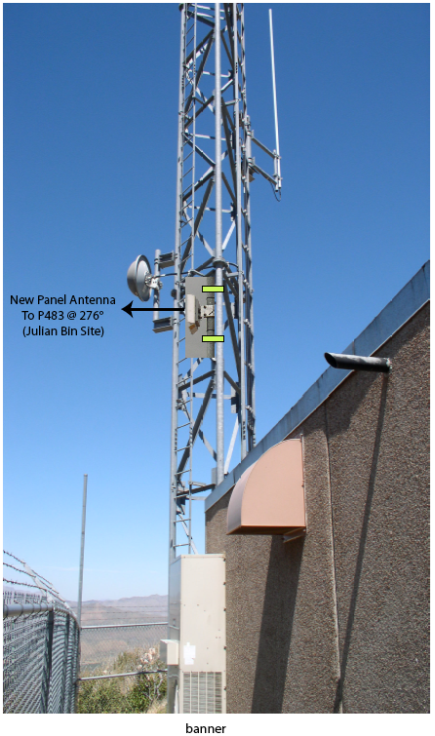
Synergies with other Organizations –
Variety of CRTN Users
CGPS Network
Data
Models
Data
CRTN Server
NSRS/CSRS Coordinates
Ultra-rapid SOPAC Orbits
NOAATrop Model
Ionosphere Model
Crustal Motion Model
Geoid Model
RTD Server, SOPAC Database, Web Services, GPS Explorer SOPAC Utilities
GPS Station
Communications
multiple data streams
Multi-Base User
CSRC
NMEA (CSRS)
RTCM
EEWS
RTCM (CSRS)
1 Hz Displacements
Positioning Service User
Single-Base User
Troposphere Delays

Slide 40
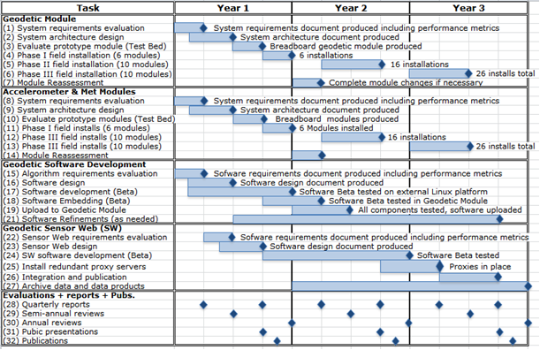
Schedule – Years one to three
Start of project: May 15, 2012

Slide 41
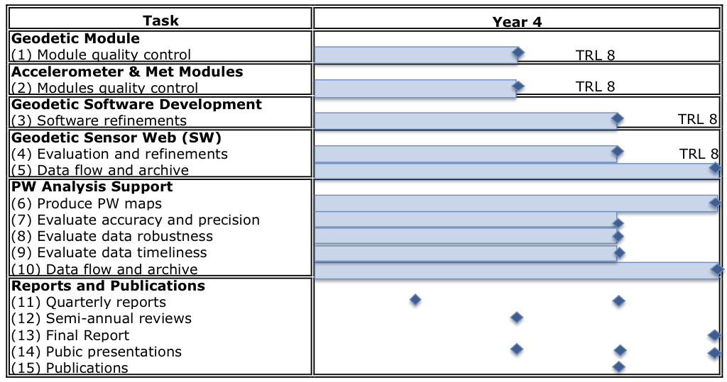
Schedule – year 4
Infusion at NOAA

Slide 42
Task and Schedule Status
1. Develop a power-efficient, low-cost, plug-in Geodetic Module as a prototype for the next-generation geodetic station, including GPS, accelerometer and meteorological sensors
System requirements evaluation
System architecture design
Evaluate prototype modules
Phase I field installation (6 modules)
Phase II field installation (10 modules)
Phase III field installation (10 modules)
Modules reassessment
Target date: November 15, 2014
Reviewed system requirements – No alterations needed
17 Geodetic Module and MEMS accelerometer packages deployed and operational at real-time GPS stations across the southern San Andreas fault system
Testing capabilities of MEMS met sensors for PWV estimation at a station near SIO, compared to top of the line met sensor at the site.
Shake table tests in early December (2013) will be done to field test MEMS accelerometers when subjected to seismic shaking
Excellent progress towards project goals
Notes:
42

Slide 43
Task and Schedule Status
2. Generate on-the-fly higher-order data products including millimeter-level displacements and precipitable water within the geodetic module rather than at a central processing facility as has been the prevailing paradigm
Algorithm requirements evaluations
Software design
Software development
Software embedding in Geodetic Module
Upload to Geodetic Module
Software reassessment
Target date: February 15, 2015
Reviewed system requirements – No alterations needed
Conducted shake table tests to reevaluate Kalman filter software
Implemented PPP-AR service for satellite clocks and FCBs
Conversion of PPP-AR Fortran code to Java environment (in progress)
Used PPP-AR to estimate broadband displacements for August 26, 2012 Brawley swarm
Published 2 studies on 2011 Mw 9.0 Tohoku-oki earthquake & tsunami
Implemented server-based Kalman filter to produce seismogeodetic displacements
Excellent progress towards project goals
Notes:
43

Slide 44
Task and Schedule Status
3. Develop a real-time Sensor Web to allow autonomous sensors to transmit and receive information with the geodetic module via regional nodes and central facilities to allow for control functions, data, data product, model exchanges and alarming
Sensor Web requirements evaluation
Design
Software development
Install redundant proxy servers
Integration and publication
Archive data and data products
Target Date: May 14, 2015
Tested e-Vigilio system for distribution of alerts
Implemented ERYO format at SOPAC and SCEDC
Implemented new accelerometer & meteorological data formats
Several meetings with San Diego County Office of Emergency Services and UCSD Health Services at UCSD Medical Center in Hillcrest to discuss protocols and monitoring
Developing prototype interactive interface for GPS met weather forecasting with NOAA partners for consideration by NOAA AWIPS developers
Sensor Web requirements will be driven by data users at local agencies and NOAA
Notes:
44

Slide 45
Task and Schedule Status
4. Transfer capabilities to NOAA (and CISN) as part of a technology infusion proposal, for decision and rapid response to natural hazards emergencies including earthquakes, tsunamis, severe storms, atmospheric rivers, and flooding
Evaluate Geodetic Module
Evaluate MEMS accelerometer and meteorological packages
Evaluate Geodetic Sensor Web
PW analysis support
Target Date: May 14, 2016
Identified suitable met sensors and completed met package design
Incorporated 26 southern California stations into ESRL’s ongoing GPS-Met operations
Demonstrated utility of densified GPS PWV in NWS offices during 2012 and 2013 monsoon seasons in southern California
Testing prototype MEMS met package at GPS station to evaluate PWV estimates
Excellent progress towards project goals
Notes:
45
45

Slide 46
Costs – UCSD
(for duration of project; includes Caltech subaward)
AIST-11 Next-Generation Real-Time Geodetic Station Sensor Web
for Natural Hazards Research and Applications

Slide 47
Costs – JPL
(for duration of project)
AIST-11 Next-Generation Real-Time Geodetic Station Sensor Web
for Natural Hazards Research and Applications

Slide 48
JPL Workforce

Slide 49
Costs – Entire Project
(for duration of project)
AIST-11 Next-Generation Real-Time Geodetic Station Sensor Web
for Natural Hazards Research and Applications

Slide 50
Acronyms – I
ACE Ambiguity, clock, ephemeris estimates
ARIA Advanced Rapid Imaging and Analysis
BARD Bay Area Regional Deformation Array (at UC Berkley)
CGPS Continuous Global Positioning System
CISN California Integrated Seismic Network
CMT Centroid Moment Tensor
CRTN California Real Time Network
CSRC California Spatial Reference Center
EEWS Earthquake Early Warning System
ESDR Earth Science Data Record
GAM GPS, Accelerometer, Meteorological raw data
GEONET GNSS Earth Observation Network System (Japan)
IGS International GNSS Service
ITRF International Terrestrial Reference Frame
JMA Japan Meteorological Agency
MEMS Microelectromechanical systems
NCEDC Northern California Earthquake Data Center (at UC Berkeley)
NIED National Research Institute for Earth Science and Disaster Prevention (Japan)
PANGA Pacific Northwest GPS Array (Central Washington Univ.)
PBO Plate Boundary Observatory (part of EarthScope project)
PPP-AR Precise Point Positioning with Ambiguity Resolution
READI Real-Time Earthquake Analysis for Disaster Mitigation Network
RTK Real-Time Kinematic Surveying
SCEDC Southern California Earthquake Data Center (at Caltech)
SCIGN Southern California Integrated GPS Network
SGM Seismogeodesy and GPS meteorology analysis and output
SOPAC Scripps Orbit and Permanent Array Center (at SIO)
UNAM Universidad Nacional Autónoma de México
UNAVCO University consortium for geoscience research and education using geodesy
WCDA Western Canada Deformation Array (at Pacific Geoscience Centre)

Slide 51
Acronyms – II (meteorological)
AWIPS Advanced Weather Interactive Processing System
ESRL Earth Systems Research Laboratory, NOAA
GFS Global Forecast System
LAPS LAPS Local Analysis and Prediction System
MADIS Meteorological Assimilation Data Ingest System
NAM North American Mesoscale
NCEP National Centers for Environmental Prediction
NOAA National Oceanic and Atmospheric Administration
NWS National Weather Service, NOAA
PWV Precipitable Water Vapor
RAP NCEP Rapid Refresh
RUC Rapid Update Cycle
SOO Science and Operations Officer
WFO Weather Forecast Office
ZHD Zenith Hydrostatic Delay
ZTD Zenith Total Delay or Zenith Troposphere Delay
ZWD Zenith Wet Delay

